Slide 1
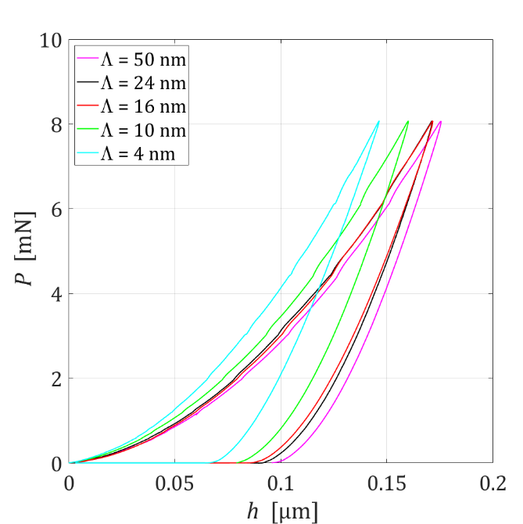
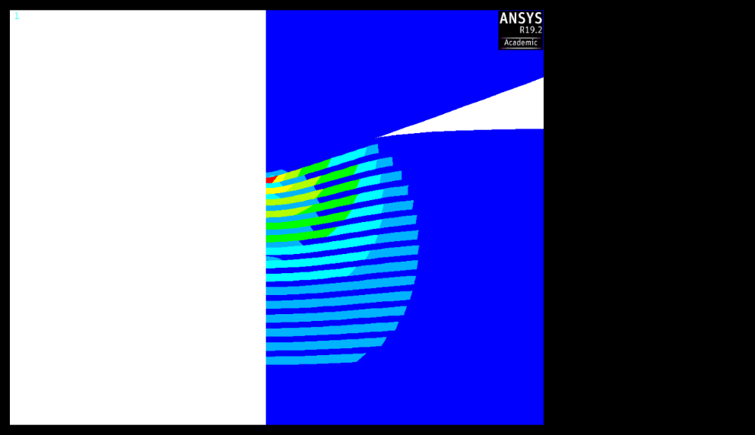
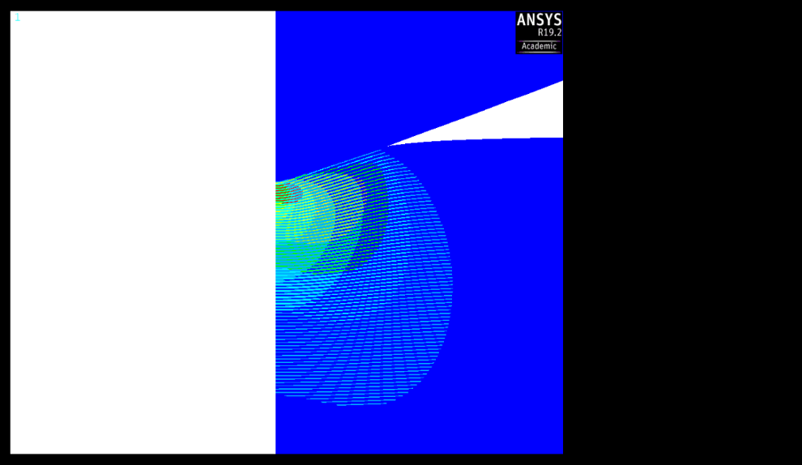
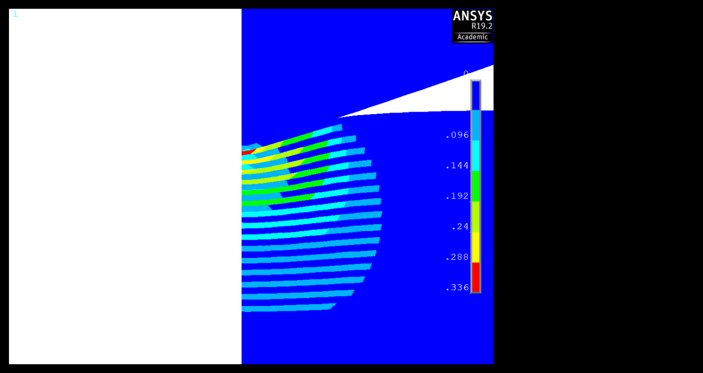

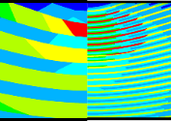
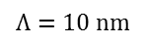
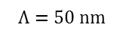
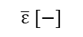
The 2 objectives of the NANOSTRAT project:
•Model the nanoindentation of TiAl / TiAlN nanostratified coatings in order to understand the elastoplastic phenomena that generate the increase of hardness at the lowest periods (superlattice effect)
•Numerically optimize the stratification (period, number of layers, ...) in order to obtain nanostratified TiAl / TiAlN ultra-hard.
$$Λ=50 nm$$
$$Λ=10 nm$$
$$\overline{ε} [−]$$
0.336
Increase of hardness
0.288
0.240
0.192
0.144
0.096
0.048
100 nm
0.000
Equivalent plastic strain field and deformed shape in TiAl/TiAlN multilayer coatings for two stacking periods (50 nm and 10 nm) at the same loading force.
P-h experimental indentation curve of a multilayer coating for several stacking periods Λ.
M.-J. Pac, S. Giljean, C. Rousselot, F. Richard, et P. Delobelle, « Microstructural and elasto-plastic material parameters identification by inverse finite elements method of Ti(1−x)AlxN », Thin Solid Films, vol. 569, p. 81‑92, oct. 2014,
M.-J. Pac et al., « Investigation of Ti0.54Al0.46/Ti0.54Al0.46N multilayer films deposited by reactive gas pulsing process by nano-indentation and electron energy-loss spectroscopy », Thin Solid Films, vol. 634, p. 96‑106, juill. 2017

Slide 2
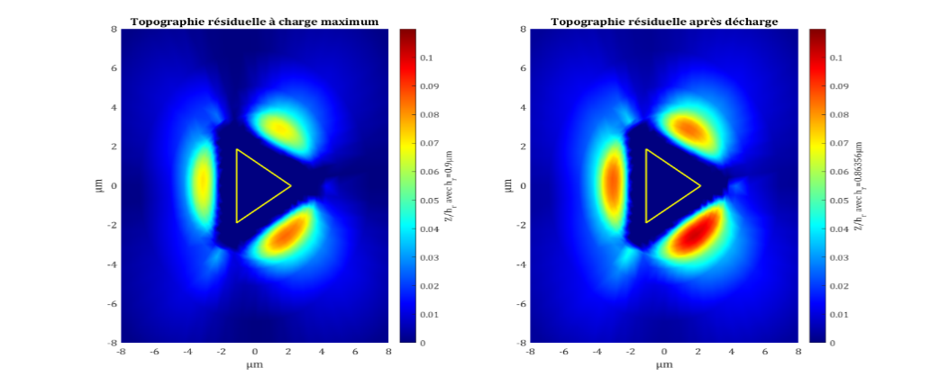
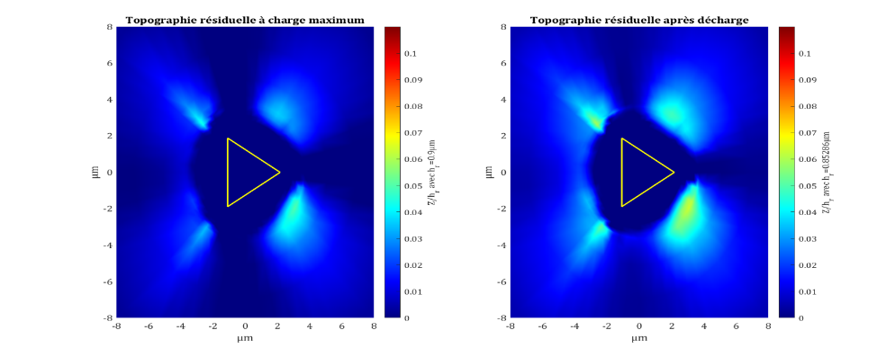
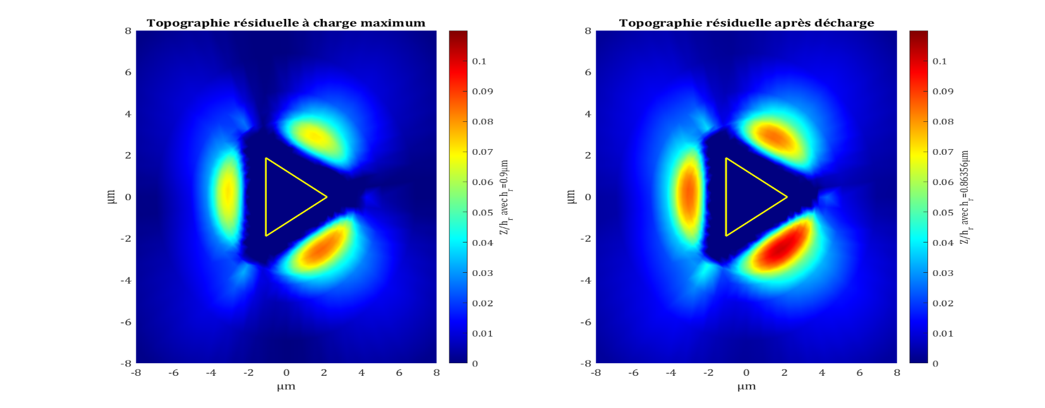
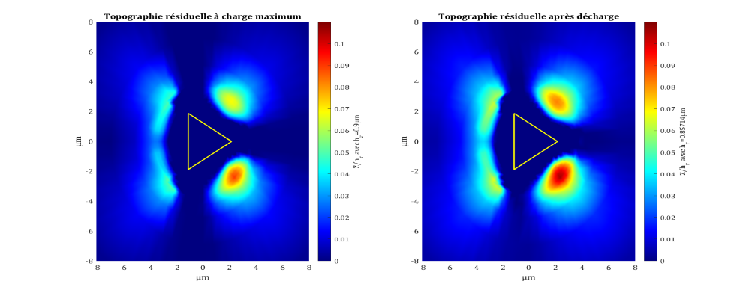

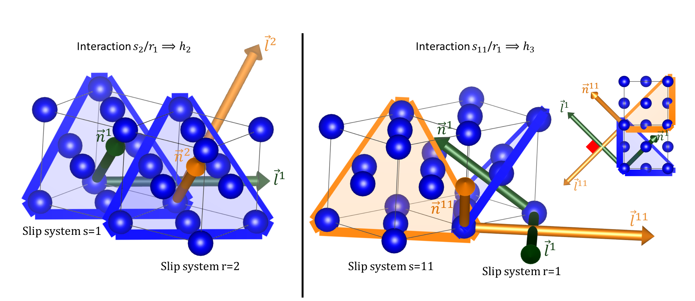
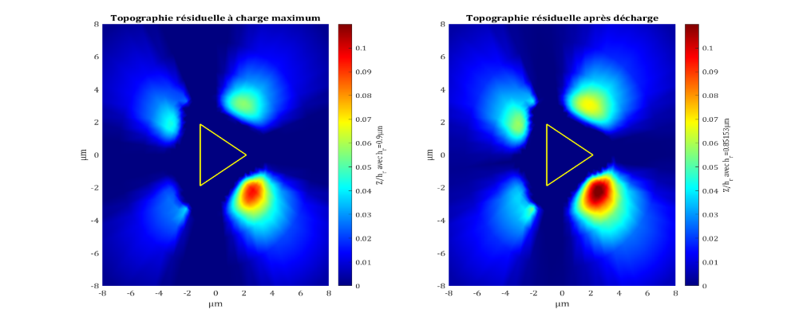
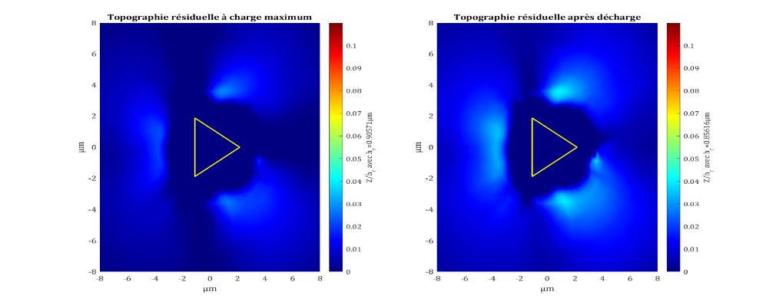










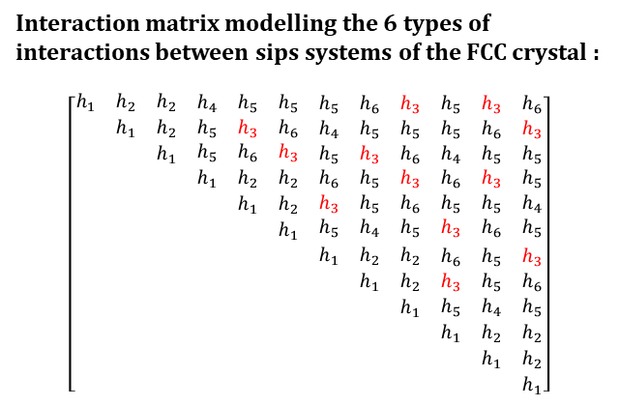



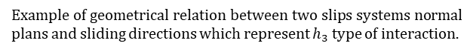
The project target : identify the interaction matrix coefficient using residual indentation topographies, which are really sensitives to those coefficients. Those matrix coefficients characterise the hardening at microscopic scale of the material, considering the crystal and is orientation. Each coefficients of the matrix is related to interactions between slips systems of the crystal. This project is concentrated to one material, FCC nickel material, and for FCC crystal there are twelve slips systems and six interactions types.
Interaction matrix modelling the 6 types of interactions between sips systems of the FCC crystal :
$$\left[\begin{matrix}\begin{matrix}\begin{matrix}h_{1} & h_{2} & h_{2} \\ & h_{1} & h_{2} \\ & & h_{1}\end{matrix} & \begin{matrix}h_{4} & h_{5} & h_{5} \\ h_{5} & h_{3} & h_{6} \\ h_{5} & h_{6} & h_{3}\end{matrix} \\ \begin{matrix} & & \\ & & \\ & & \end{matrix} & \begin{matrix}h_{1} & h_{2} & h_{2} \\ & h_{1} & h_{2} \\ & & h_{1}\end{matrix}\end{matrix} & \begin{matrix}\begin{matrix}h_{5} & h_{6} & h_{3} \\ h_{4} & h_{5} & h_{5} \\ h_{5} & h_{3} & h_{6}\end{matrix} & \begin{matrix}h_{5} & h_{3} & h_{6} \\ h_{5} & h_{6} & h_{3} \\ h_{4} & h_{5} & h_{5}\end{matrix} \\ \begin{matrix}h_{6} & h_{5} & h_{3} \\ h_{3} & h_{5} & h_{6} \\ h_{5} & h_{4} & h_{5}\end{matrix} & \begin{matrix}h_{6} & h_{3} & h_{5} \\ h_{5} & h_{5} & h_{4} \\ h_{3} & h_{6} & h_{5}\end{matrix}\end{matrix} \\ \begin{matrix}\begin{matrix} & & \\ & & \\ & & \end{matrix} & \begin{matrix} & & \\ & & \\ & & \end{matrix} \\ \begin{matrix} & & \\ & & \\ & & \end{matrix} & \begin{matrix} & & \\ & & \\ & & \end{matrix}\end{matrix} & \begin{matrix}\begin{matrix}h_{1} & h_{2} & h_{2} \\ & h_{1} & h_{2} \\ & & h_{1}\end{matrix} & \begin{matrix}h_{6} & h_{5} & h_{3} \\ h_{3} & h_{5} & h_{6} \\ h_{5} & h_{4} & h_{5}\end{matrix} \\ \begin{matrix} & & \\ & & \\ & & \end{matrix} & \begin{matrix}h_{1} & h_{2} & h_{2} \\ & h_{1} & h_{2} \\ & & h_{1}\end{matrix}\end{matrix}\end{matrix}\right]$$
Numerical topographies (001)
AFM topographies
$$h_{1}$$
$$h_{2}$$
$$h_{3}$$
$$h_{4}$$
?
Symmetry
$$m_{2}$$
$$m_{3}$$
$$Z/h_{r}$$
$$h_{5}$$
$$h_{6}$$
$$m_{4}$$
$$m_{5}$$
Top view
Example of geometrical relation between two slips systems normal plans and sliding directions which represent $h_{3}$ type of interaction.
$$m_{6}$$
Experimental AFM topographies use to identify the coefficient matrix.
Simulated indentation topographies normalized by the residual indentation depth.
$$m_{7}$$

Slide 3
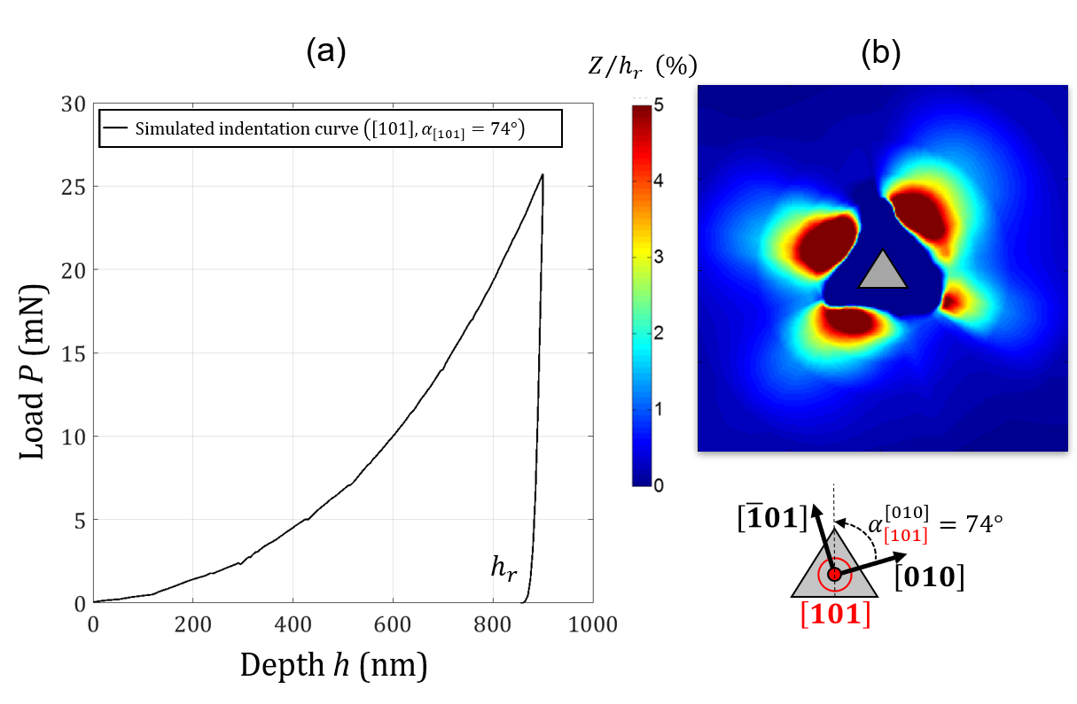
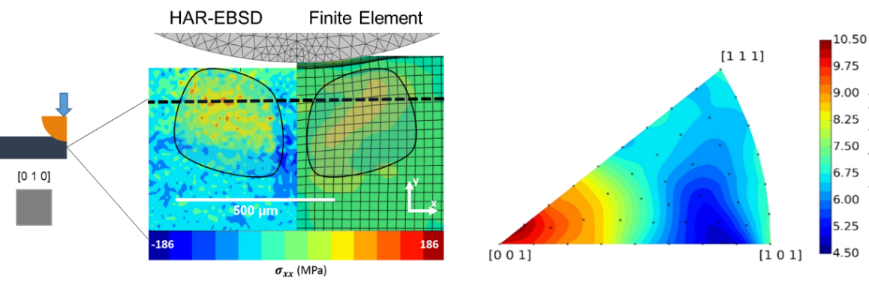
The NOTIFICATION project targets the robust and quick identification of the parameters driving the interaction matrix of a crystal plasticity law using nanoindentation and some associated metrology. The project focuses on pure FCC nickel and copper, but the approach is intended to be applicable to any crystalline material and will be will therefore be tested on nickel-based superalloys.
Left - residual stress measurement over a spherical indentation cross-section using HR EBSD and comparison with CPFEM. Right: effect of crystal orientation (Inverse Pole Figure) on the volume fraction of elements under tensile residual stress
Nanoindentation CPFEM simulation performed in the $\left[101\right]$ grain orientation with azimuth $α$ using a virtual material: (a) indentation curve (b) residual topography
E. Renner, A. Bourceret, Y. Gaillard, F. Amiot, P. Delobelle, F. Richard, 2020. Identifiability of single crystal plasticity parameters from residual topographies in Berkovich nanoindentation on FCC nickel, Journal of the Mechanics and Physics of Solids, vol. 138 , InPress
Breumier, S., Villani, A., Maurice, C., Lévesque, M., Kermouche, G., 2019. Effect of crystal orientation on indentation-induced residual stress field: Simulation and experimental validation. Materials & Design 169, 107659

Slide 4
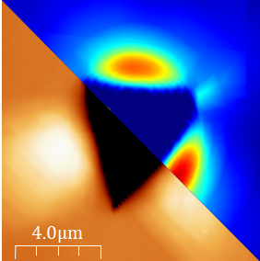
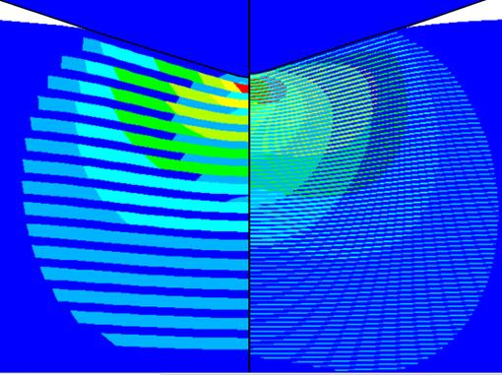
Les Propositions d’image d’accueil

